Slide 1
HORMONES & GROWTH-REGULATING CHEMICALS Growth Retardants
Synthetic and natural growth retardants are sold under the trade names A-Rest®, B-Nine®, Bonzi®, Sumagic®, Cycocel®, and others.
Used on florist crops such as poinsettia & chrysanthemum.
They slow elongation of stems, making sturdier, fuller plants.
On fruit crops they improve color, firmness & storage life.
They act as anti-gibberellins
Inhibit plant synthesis of gibberellin
Or block the receptor sites of gibberellin so the plant does not sense the hormone

Slide 2
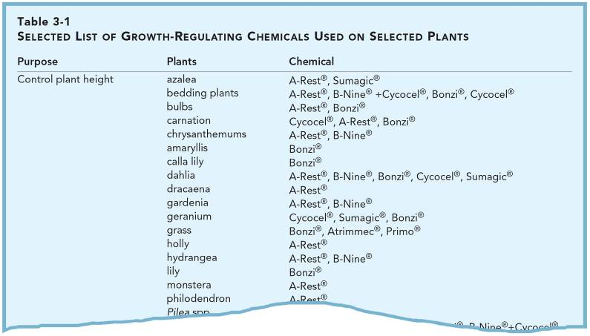
HORMONES & GROWTH-REGULATING CHEMICALS
See the entire list on page 41 your textbook.

Slide 3
HORMONES & GROWTH-REGULATING CHEMICALS Growth Retardants
Growth retardants can be used on hedges and lawns to slow growth and decrease maintenance.
TREATED UNTREATED
They can also be used to maintain bedding plants in a compact size, giving plants a neater appearance in formal landscapes.
Figure 3-10 A shrub treated (left) and untreated (right) with Atrimmec® growth retardant. Courtesy of PBI/Gordon Company, Kansas City, Mo.

Slide 4
HORMONES & GROWTH-REGULATING CHEMICALS Growth Retardants
Abscisic acid (ABA) is a growth retardant that may induce abscission and does induce dormancy and inhibit seed germination.
Its action can be counteracted by growth-inducing chemicals such as auxins, gibberellins, and cytokinins.
Appears to be very involved with stress resistance.

Slide 5
HORMONES & GROWTH-REGULATING CHEMICALS Growth Retardants
A number of growth retardants have also been used to control lawn growth & reduce mowing frequency.
Maleic hydrazide & mefluidide reduce growth or stop flowering.
EPTC and amidochlor reduce growth or flowering.
But cannot stop it completely.
These chemicals must be used carefully, and the results are not always predictable.
Unacceptable color loss, injury and lessened ability of the turf to recover from disease & pest problems can result.

Slide 6
HORMONES & GROWTH-REGULATING CHEMICALS Growth Retardants
Ethylene is a retardant, with use dates to Chinese practices of ripening fruits in incense-filled rooms.
Later determined to be ethylene gas given off in the fumes that caused the accelerated ripening.
Ethylene is also produced by the ripening fruits themselves, wounded plant parts or by cut flowers.
It can be manufactured.
Is a by-product of incomplete combusion
Ethylene also ages plant parts such as flowers, causing them to abscise, and induces flowering in a limited number of species.

Slide 7
HORMONES & GROWTH-REGULATING CHEMICALS Growth Retardants
Pineapples and other members of the bromeliad family will bloom when treated with ethylene.
In commercial greenhouses, the product used for ethylene generation is Florel® or ethephon.

Slide 8
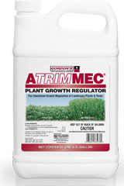
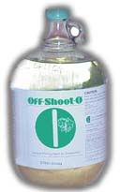
HORMONES & GROWTH-REGULATING CHEMICALS Pinching Agents
Pinching agent chemicals are used commercially to kill terminal vegetative buds.
To promote branching & a more bushy, attractive plant.
OffShoot-0® & Atrimmec® are mainly used for this purpose.

Slide 9
HORMONES & GROWTH-REGULATING CHEMICALS Vitamins
Vitamins are sold occasionally as stimulants for plant growth and for use after transplanting.
The same vitamins sold for human use.
But act more as hormones in plants.
Particularly B vitamins.
Vitamin effectiveness has not been determined fully.
When used on bean seeds, limited experiments have shown improved germination rates.
And decrease the time from seed sowing to harvest.
Increases in yield have been reported on some species.

Slide 10
HORMONES & GROWTH-REGULATING CHEMICALS Vitamins
Overall, it is very possible that vitamins do improve plant growth in some cases.
They should never be used in place of fertilizers or proven-effective chemicals sold for use on plants.
Often the B-vitamins are mixed with Auxins and fertilizers
Then impossible to determine what compound us really the useful one
It is known that plants manufacture thiamine (B1) in leaves where it moves to roots
Unlikely to be deficient since they manufacture what they need

