Slide 1
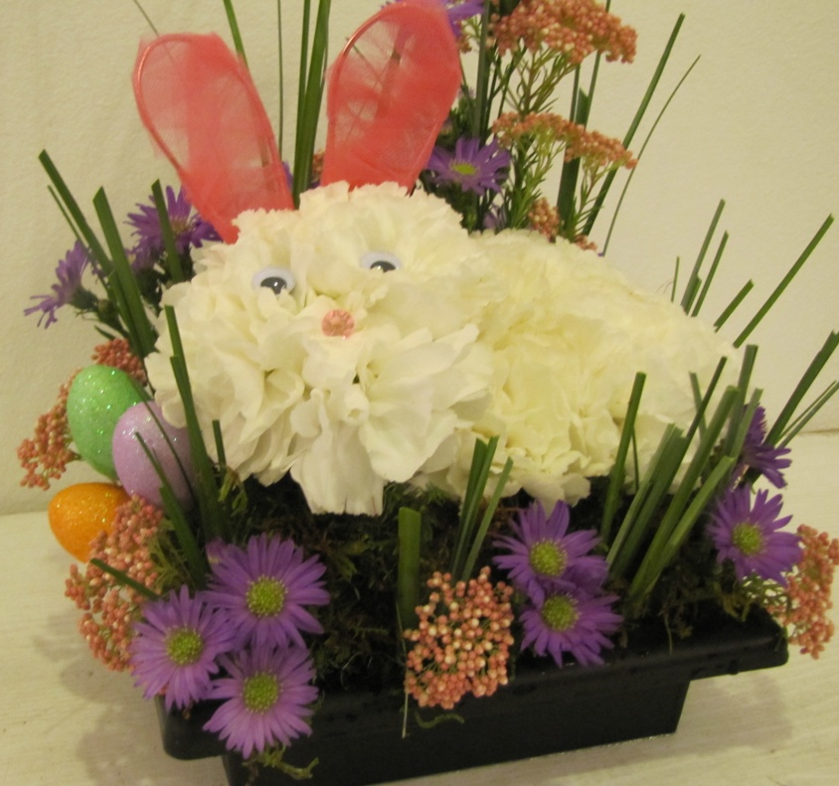
Spring Bunny

Slide 2
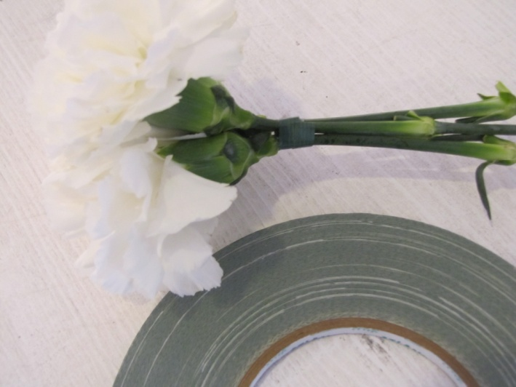
Constructing the Bunny
Add 2/3 brick of pre-soaked floral foam to the container
Wrap 3 carnations together to form the head
Secure with a small piece of waterproof tape

Slide 3
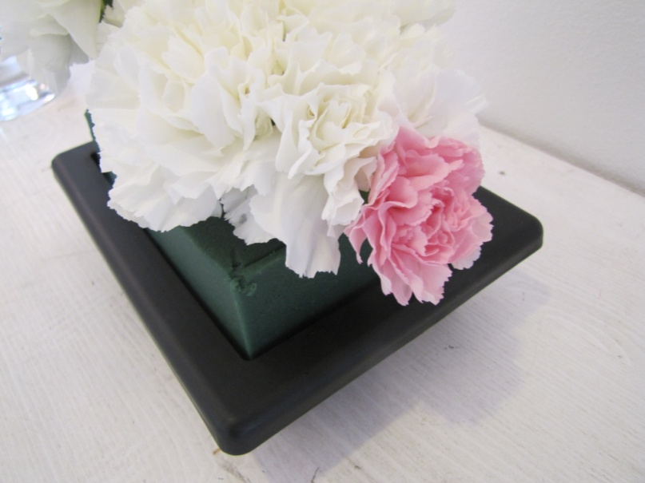
Constructing the bunny
Use 6 carnations to form the body of the bunny
Add a mini carnation at the back of the body to form the tail

Slide 4
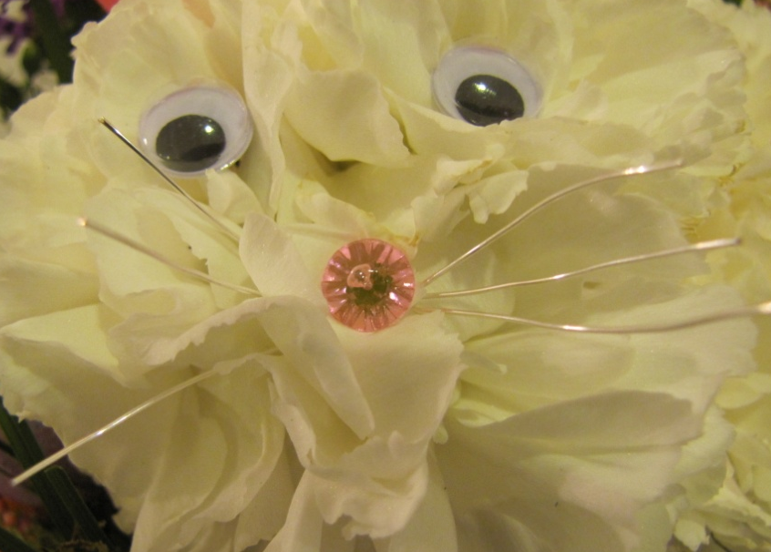
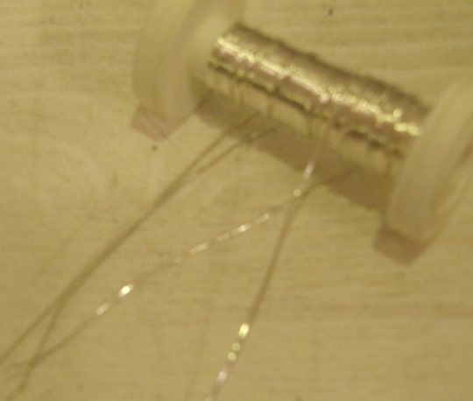
Constructing the Bunny
Add the 3 carnations at an angle to form the head
Add a pink diamonte pin to form the nose
Add two black corsage pins for the eyes
Attach googly eyes with uglu to the top of the pins
Cut 3 pieces of metallic wire around 2 ½” and thread through the carnation petals beneath the nose

Slide 5
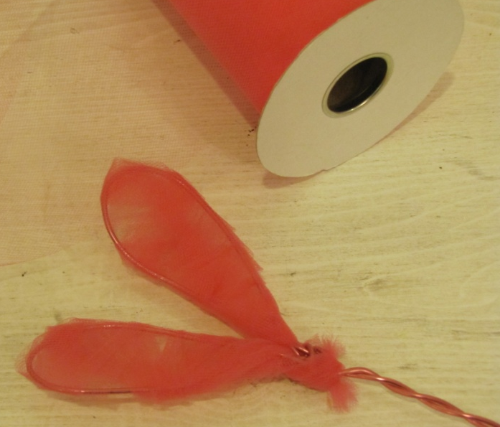
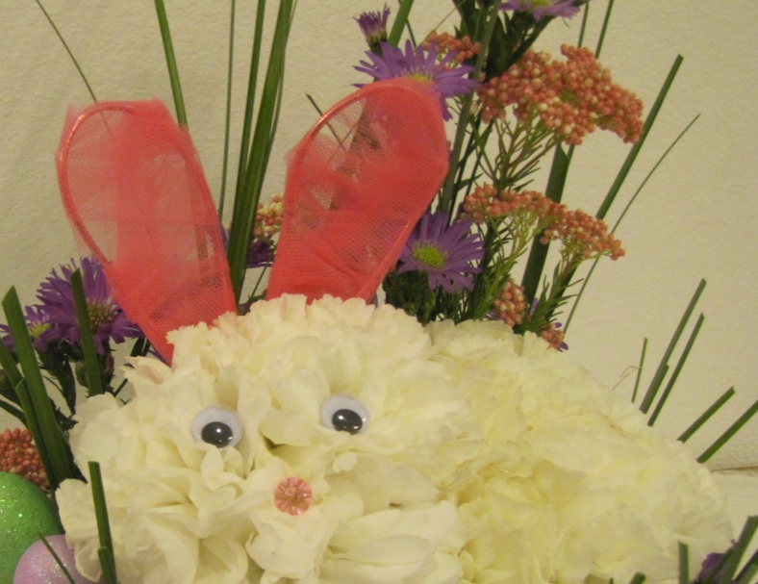
Constructing the Bunny
Bend aluminum wire into the shape of bunny ears, leave excess wire to use as a stem
Wrap ears with pink tulle

Slide 6
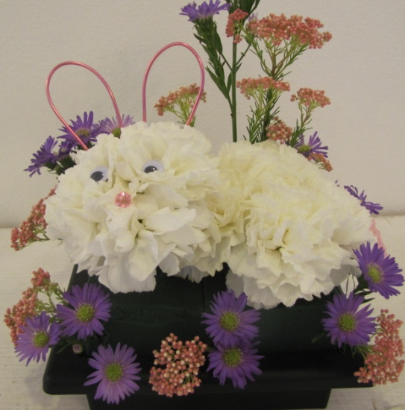
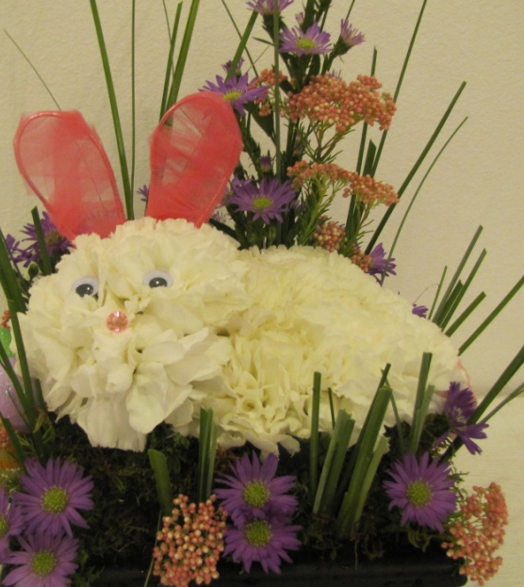
Constructing the flower garden
Add 2 sprays of purple aster, short pieces in front and tall pieces in the back of the bunny
Add pink rice flower through out garden area
Add bear grass though out garden area

Slide 7
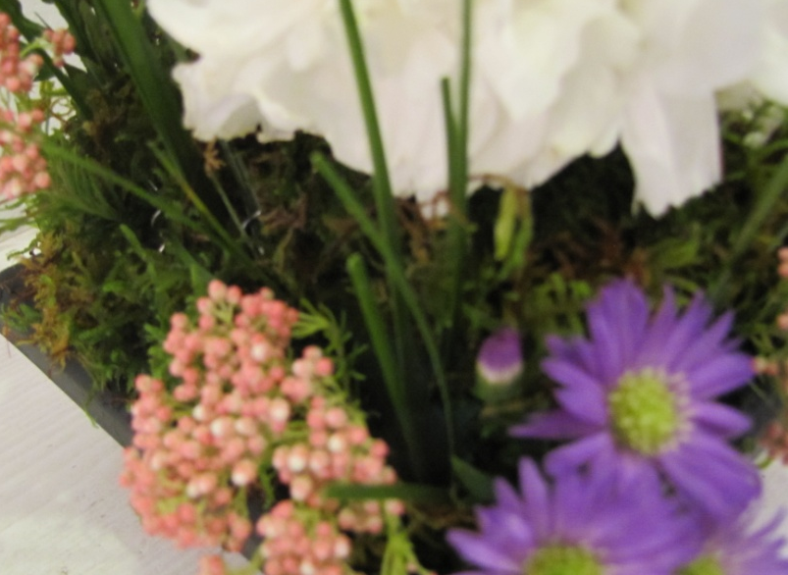
Constructing the garden
Add pre-soaked sheet moss to cover all remaining foam
Secure with greening pins
Add Easter egg accents

Slide 8
Spring bunny in flower garden

